Slide 1


公司简介
Company Profile
浙江联和电子有限公司
| 专注Focus | 品质Quality | 诚信 Integrity|
致力于成为优秀汽车连接器与家电连接器全供应链系统解决方案服务商
Committed to becoming an excellent and full supply chain system solution provider for automotive connector and home appliance connector
专注于连接器领域，包括家电 汽车 安防 工控 智能家居 储能连接器等
Focus on the field of connectors, including home appliances, automobiles, security, industrial control, smart home, energy storage connectors, etc.

Slide 2
Part 01
公司介绍 Company Introduction
Part 02
研发能力 R&D Ability
目录
Part 03
制造能力 Manufacturing Capacity
CONTENTS
Part 04
质量保障能力 Quality Assurance Capability
Part 05
认证和荣誉 Certification And Honor

Slide 3

Part 01
公司介绍 Company Introduction

Slide 4

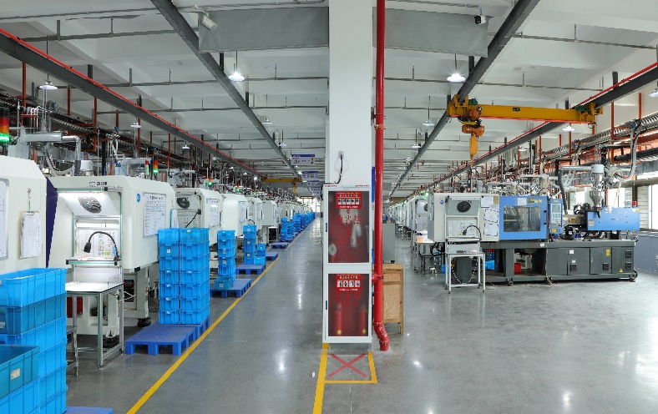
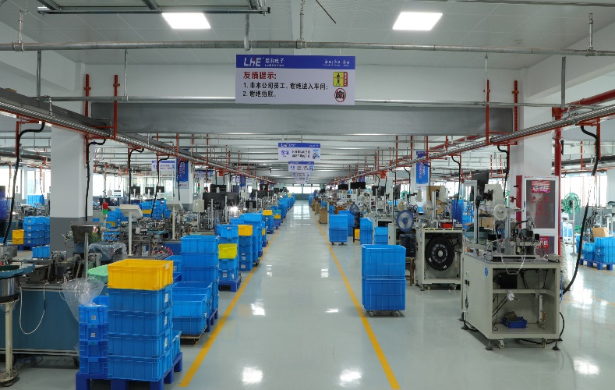
公司简介 Company profile
浙江联和电子有限公司成立于2003年，前身为乐清市联和电子厂，公司总部位于温州市乐清市乐清湾港区红旗路，厂房建筑面积50000平方米。我司二十余年深耕家电 汽车 安防 工控 智能家居 储能连接器等系列产品的生产研发，现有塑壳、端子、针座等3万种以上成品编码，覆盖1.0-6.35间距，种类齐全。公司拥有配置完善的全自动化生产线车间，保障高产能、高效率。冲压车间拥有台湾明勖高速冲床80余台，配备了完善的CCD在线监测设备，隔音设施，可年产精密端子100亿只以上；注塑车间现有90余台注塑机，全部采用中央供料系统并配备了全自动机械手，年产塑壳50亿只以上；插针车间拥有全自动插针机及端子焊着装配机共计200余台，可年产针座30亿只以上。
我司二十余年不断积累精密模具开发及制造经验，引进国内外先进的生产设备，培养造就了一批高素质的管理和技术人才，150余名经验丰富的技师队伍护航，先后通过ISO9001、 IATF /TS16949、ISO14001、ISO45001体系认证，并通过了UL、CE、VDE 、 CQC、ROHS、REACH等认证，其中350多个产品系列通过UL，20余项国家产品专利加持。
未来，我司将更注重科技研发能力的发展以及产品价值的提升，帮助客户提高家用电器及汽车领域的连接可靠性，提升装配操作的工作效率。我们在提供现有大量标准系列产品的同时也愿为客户提供定制化解决方案。提供非凡的客户体验是我们的使命，与客户协作是我们的核心，愿我们协同工作，引领全球连接器创新。
Zhejiang Lianhe Electronics Co., Ltd. was founded in 2003, Located in Yueqing, Zhejiang Province. Plant construction area of 50,000 square meters. Existing product code more than 30,000 kinds, covering 1.0-6.35 pitch.
Lianhe has a fully equipped automated production line workshop,
Stamping workshop has more than 80 high-speed presses, equipped with CCD online monitoring equipment, sound insulation facilities, Annual output more than 10 billion pieces;
Injection molding workshop have more than 90 injection molding machines, all of them adopt the central feeding system and are equipped with automatic manipulator.
Annual output more than 5 billion pieces
Assembly workshop has more than 200 automatic pin inserting machines and terminal welding assembly machines, meanwhile produce more than 3 billion pieces every year.
Our company has accumulated more than 20 years of precision mold development and manufacturing experience, introduction of domestic and foreign advanced production equipment, training a group of high-quality management and technical personnel, More than 150 experienced technicians escort, has passed ISO9001, IATF /TS16949, ISO14001, ISO45001 system certification,
And through UL, CE,VDE, CQC, ROHS, REACH and other certifications, more than 350 product series through UL, more than 20 national product patents.

Slide 5


发展历程 Development Path
2003
2014
2017
2019
2022
乐清联和电子厂成立
Yueqing Lianhe electronics factory was established
取得ISO9001认证，并通过了UL、CUL、CE、CQC、ROHS、REACH
等认证
意大利办事处成立
汽车连接器事业部成立分公司
Get ISO9001, UL, CUL,CE,CQC,ROHS,REACH,
Establishment of Italian office
Established a auto connector branch company
进驻乐清湾临港工业区厂房，
同期开工建设50000㎡厂房，
Move to new factory (25000㎡)
Start to build 50,000㎡ factory at same time.
取得IATF16949体系认证，
并荣获“国家高新技术企业”
为乐清利奇马台风受灾地区捐献一份力量
Get IATF16949
Get "National high-tech Enterprise“
Donate to Yueqing Lekima typhoon affected areas
取得ISO45001体系认证，10月进驻50000㎡新厂房
汽车连接器事业部累计成交客户200余家.
2021年销售额突破5000余万
获得浙江省专精特新中小企业荣誉证书
Get ISO45001 Enter new factory(50000㎡)
The auto connector Dept have more than 200 customers
Sales volume over 50 million in 2021
Zhejiang Province special special new small and medium-sized enterprise honorary certificate
2010
2016
2018
2020
2023
导入ERP以及OA系统，涉足国际业务，同年更名为浙江联和电 子有限公司
Add ERP and OA system
Start international business
Changed name to Zhejiang Lianhe Electronics Co Ltd
25000m²乐清湾临港企业总部开工建设，同年产值破亿
To Build New 25,000m²
Output value exceeded 100 million
西班牙办事处成立
荣获2018年度安全生产工作“先进单位 ”
Establishment of Spanish office
Honored as "Advanced Unit" for Safety in 2018
取得ISO14001体系认证
2020年度放心消费单位（放心工厂）
Get ISO14001
2020 Assured Consumer Unit (Assured Factory)
韩国办事处成立
Establishment of Korea Offic

Slide 6




关于我们 About us
Capital 资本 RMB/人民币
净资产 Net assets ：480,000,000RMB
Capability 能力
注塑，冲压，自动化及模具加工
Injection molding, Stamping,
Automation, Mold processing
生产基地 (Area): 50000m²
公司员工(Company employees) ：350人
Product 产品
家电 汽车 安防 工控 智能家居
储能连接器等系列产品
Home Appliances, Automobile, Security, Industrial Control, Smart Home, Energy storage connectors etc. series connector
LHE 致力成为优秀汽车连接器与家电连接器全供应链系统解决方案服务商
LHE Committed to becoming an excellent and full supply chain system solution provider for automotive connector and home appliance connector

Slide 7
董事长
Chairman
总经理
GM
副总经理
VGM
行政部
HR
人事部
HRD
后勤部
GLD
财务部
FC
销售部
SD
国内贸易部
MD
国际贸易部
MOFCOM
采购部
PD
统筹部
PMC
计划部
Planning dept
仓储部
WB
品质部
QCU终检组FQC
冲压车间QC
Stamping
注塑车间QC
Injection
压针车间QC
Needle pressing
终检组FQC
技术/工程部
EO/PO
冲模组
Die set
塑模组
Plastic Die
机加车间
Machining
生产部
PC
冲压车间
Stamping Workshop
注塑车间
Injection Workshop
压针车间
Needle pressing Workshop
信息中心
IT
实验Lab
组织结构

Slide 8
年销售额 Annual sales
2005-2022年营业额实现十倍增长
2023年营业额目标：35000万元
Turnover increased tenfold from 2005 to 2022
2023 turnover target: 350 million RMB

Slide 9
销售占比 Sales Ratio

Slide 10
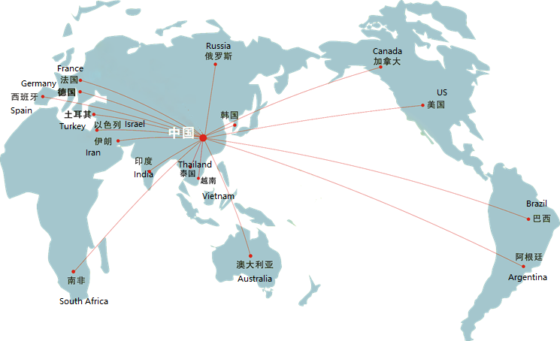
营销网络 Marketing Network
海外业务 Overseas business
3000+客户 customers
2008年LHE进入国际市场，目前LHE品牌已拓展到欧洲、北美、中东、东南亚与德国、美国、意大利、西班牙、俄罗斯等100多个等地区，国家，3000多位客户建立了良好的合作关系，颇得客户好评.
LHE entered the international market in 2008. At present, the LHE brand has expanded to Europe, North America, the Middle East, Southeast Asia and other places. It has established good cooperative relations with more than 3,000 customers in more than 100 countries including Germany, the United States, Italy, Spain, and Russia. Well received by customers 。

Slide 11
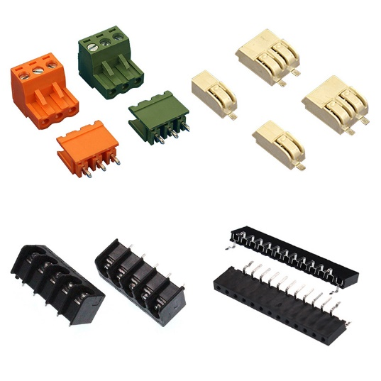
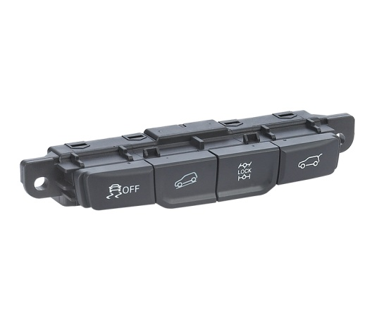
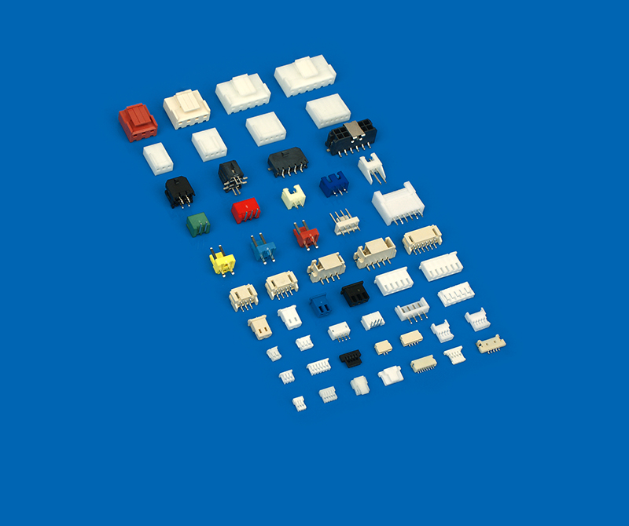
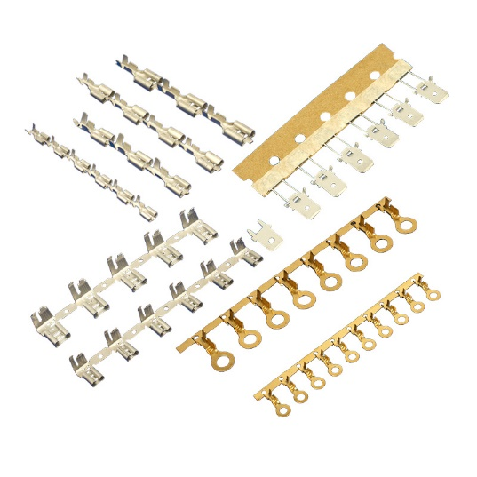
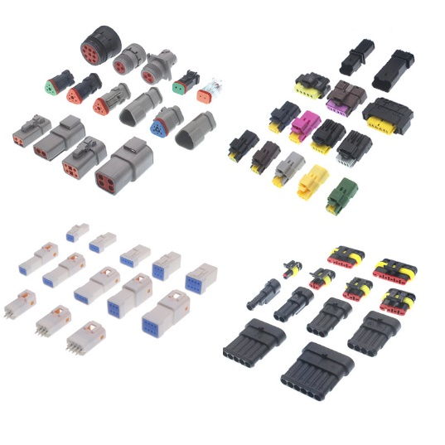
产品介绍 Product Introduction
汽车组合开关
Automotive combination switch
PCB连接器 PCB connector
汽车连接器
Automobile connector
连接器
Connector
端子
Terminal

Slide 12
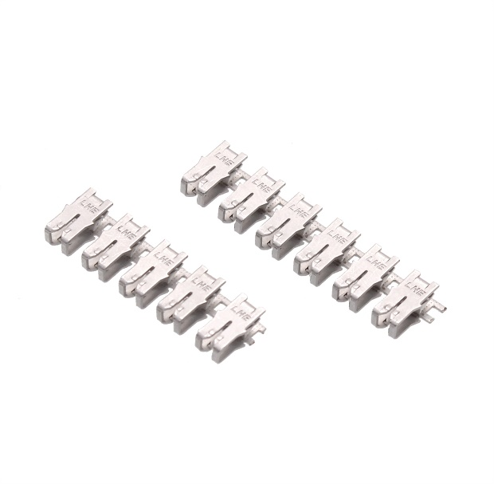
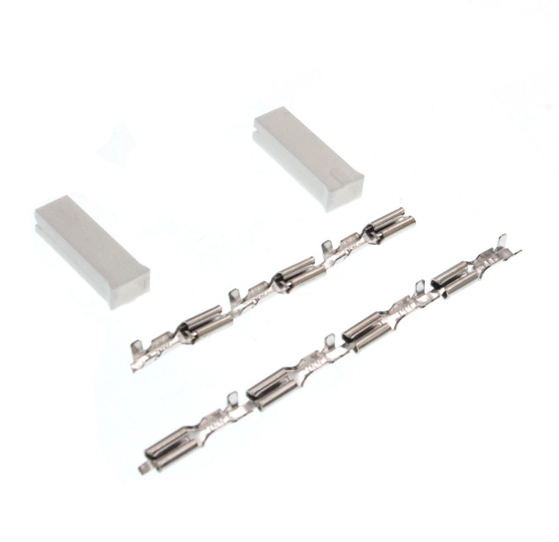
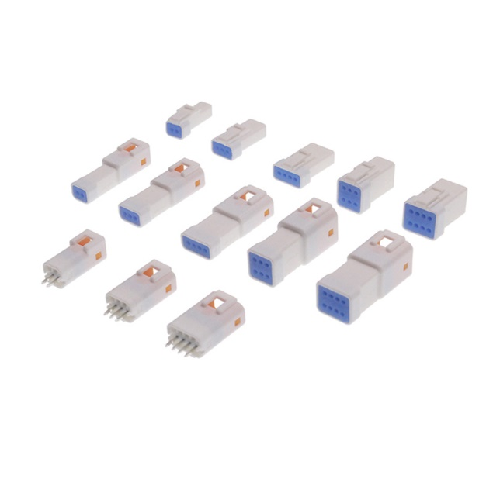
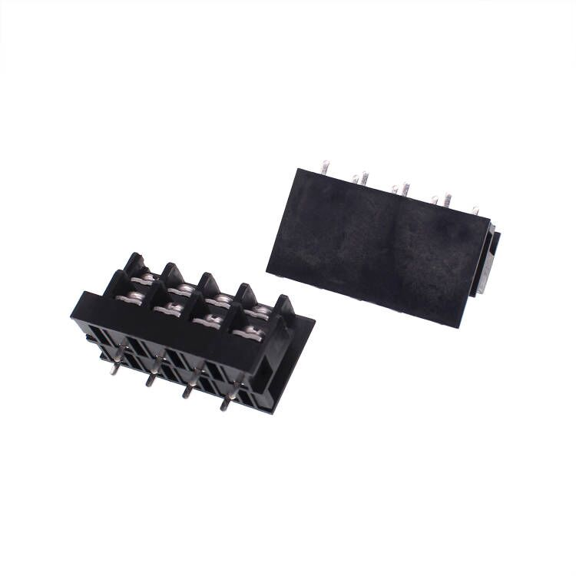
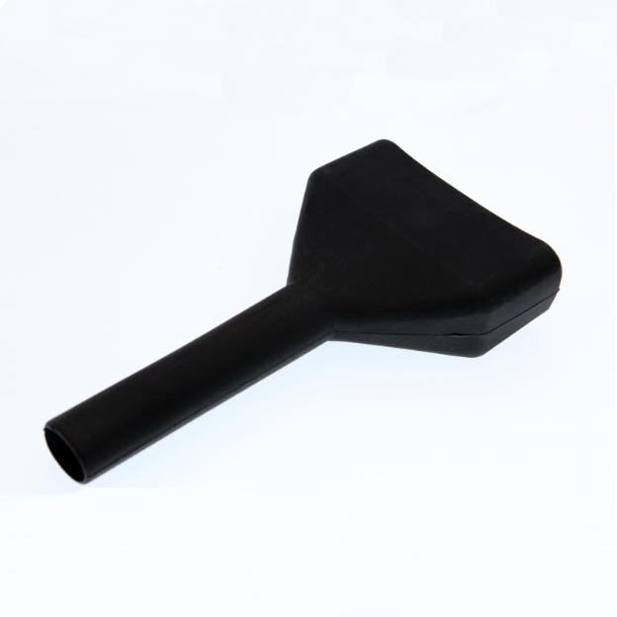
新品定制服务 New Product Customization Service
联和电子始终关注客户需求，专注研发，不断创新，我司提供塑壳、端子、针座等30000种以上成品编码，年开发80多种新品，更能为您提供从模具设计、加工到装配高度自动化的OEM/ODM定制服务。
We pays attention to customer needs, focuses on research and development, and continues to innovate. Our company provides more than 30,000 finished product codes such as housing, terminals, header, and develops more than 80 new products every year, highly automated OEM/ODM customization services.

Slide 13












主要客户展示 Main Customer Display
家电类
Home Appliances

Slide 14











主要客户展示 Main Customer Display
家电类
Home Appliances
智能家居
Smart Home

Slide 15








主要客户展示 Main Customer Display
智能卫浴类
Smart Bathroom
电动车类
Electric vehicles

Slide 16











主要客户展示 Main Customer Display
新能源类
Electric vehicles

Slide 17










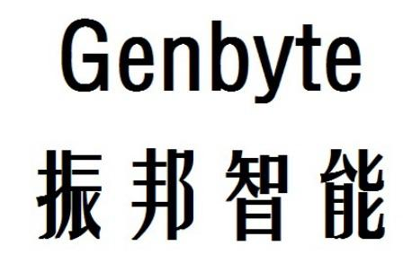



主要客户展示 Main Customer Display
PCBA类

Slide 18







主要客户展示 Main Customer Display
工具类
Tools
医疗类
Medical
安防类
Security
特种设备
Special Equipment

Slide 19
















主要客户展示 Main Customer Display
汽车类客户
Automotive

Slide 20

汽车板块案例分享 Automobile Case Sharing
2018年配合长安开发电器件,汽车集成开关,及相关结构件, 为M201及其衍生车型提供全车连接器, 配套布线方案开发.
In 2018, we cooperated with Changan to develop electrical parts, automotive integrated switch, and related structural parts, and provided all-vehicle connectors and supporting wiring solutions for M201 and its derivative models.
欧洲丰田体系, 应用车型: LPE200B, LPE200/220/250 等,
应用领域电动仓储车, 供货工厂包含: 瑞典, 波兰, 塞尔维亚等.
Applied models: LPE200B, LPE200/220/250 etc.,
Application fields Electric storage trucks, Supply factories include: Sweden, Poland, Serbia, etc.

Slide 21

汽车板块案例分享 Automobile Plate Case Sharing
金龙, 为泰国矿卡, 6016车型等车型提供连接器,
主要线束厂, 南京东捷
Provides connectors for Thai mining trucks, 6016 models and other models,
Main wiring harness factory, Nanjing Dongjie
奇瑞, 为捷途X70等提供连接器,主要线束厂海阳三贤.
Provides connectors for Jetour X70, etc., and the main wiring harness factory is Haiyang Sanxian.

Slide 22
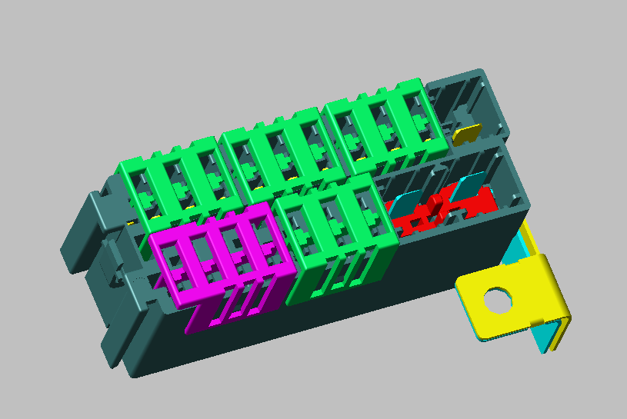
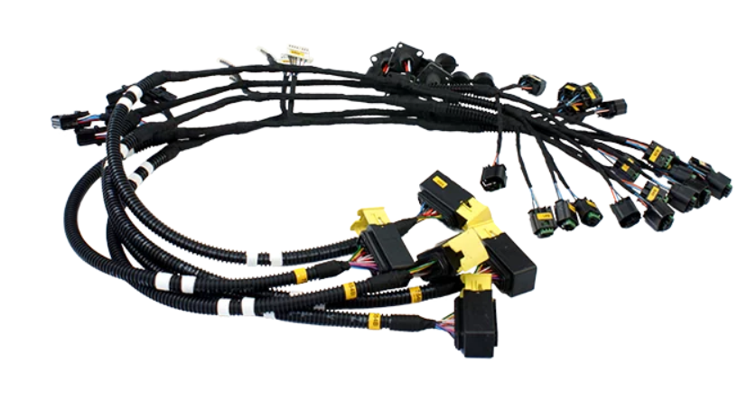
汽车板块案例分享 Automobile Plate Case Sharing
IKCO体系, 为标致及雷诺车型落地项目,提供连接器解决方案,
车型包含206, 207, 308等,配套旗下线束厂EKS
产品线包含: 防水连接器,电器盒, 开关总成.
Providing connector solutions for Peugeot and Renault model landing projects,
Models include 206, 207, 308, etc, supporting its wiring harness factory EKS
The product line includes: waterproof connector, electrical box, switch assembly.

Slide 23

汽车板块案例分享 Automobile Plate Case Sharing
越南长海体系, 配套项目 PM BUS, DK BIKE, IVC WH等
Supporting projects include PM BUS, DK BIKE, IVC WH, etc.
奥地利卢森宝亚, 提供消防车线束连接器
Rosenbauer, Austria, providing fire truck wiring harness connectors

Slide 24

汽车板块案例分享 Automobile Plate Case Sharing
SHERP, 为其ATV车型: N1200, PRO100 等提供连接器
Providing connectors for its ATV models: N1200, PRO100, etc.
KALMAR, 为飞机牵引车TBL-800等提供连接器
Providing connectors for aircraft tractor TBL-800, etc.

Slide 25

企业文化 Company Culture
联和电子
LIANHE ElECTRONIC
目标
行动
态度
细节
创新
决定方向
成就未来
决定一切
决定命运
决定成败
和谐 | 和顺 | 和美
Harmonious
Success
Perfect

Slide 26
Part 02
研发能力
R & D Capabilities

Slide 27
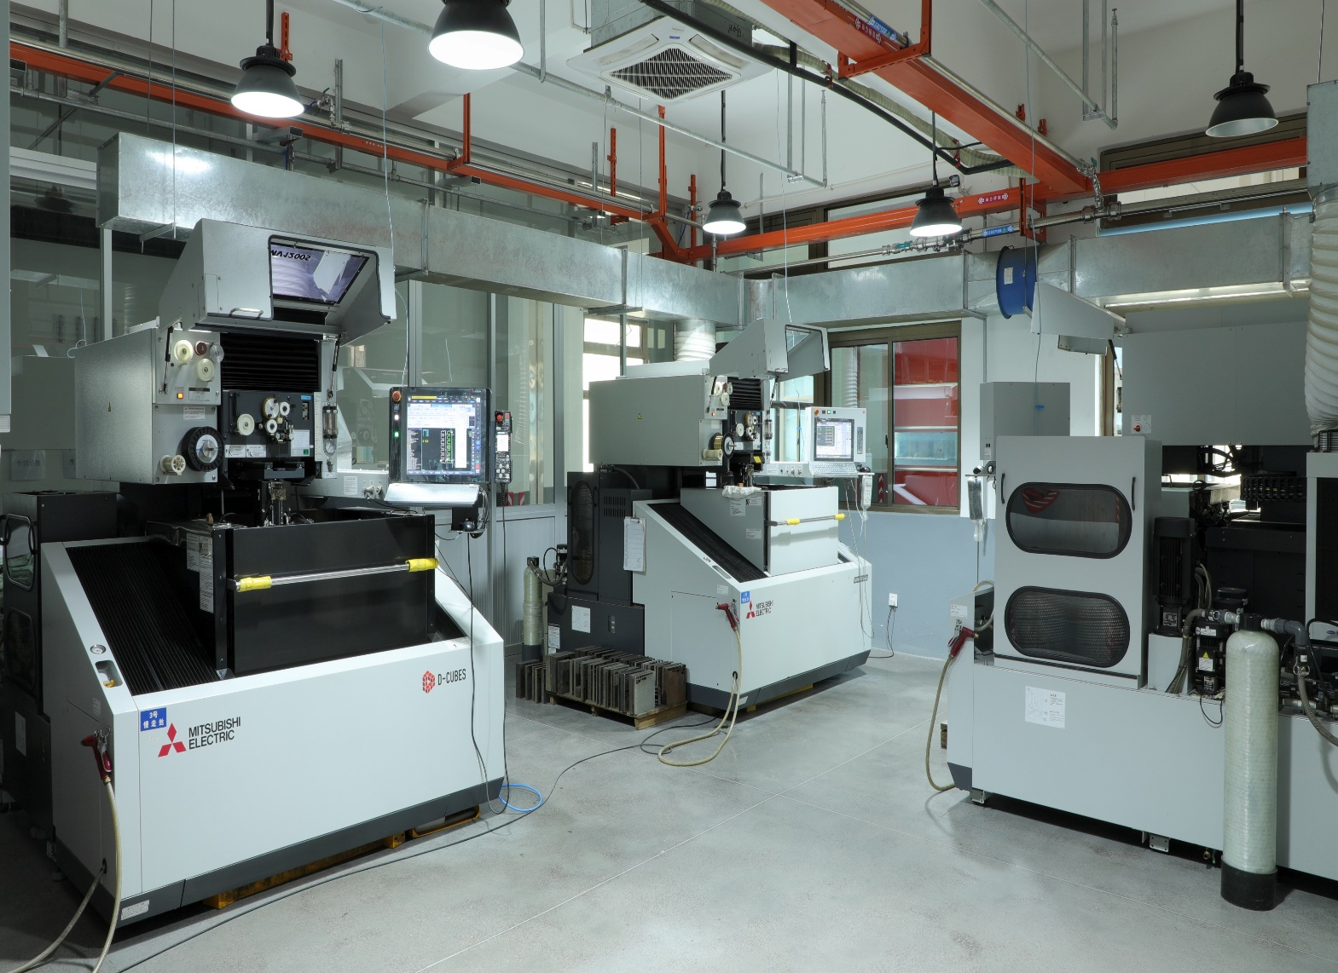
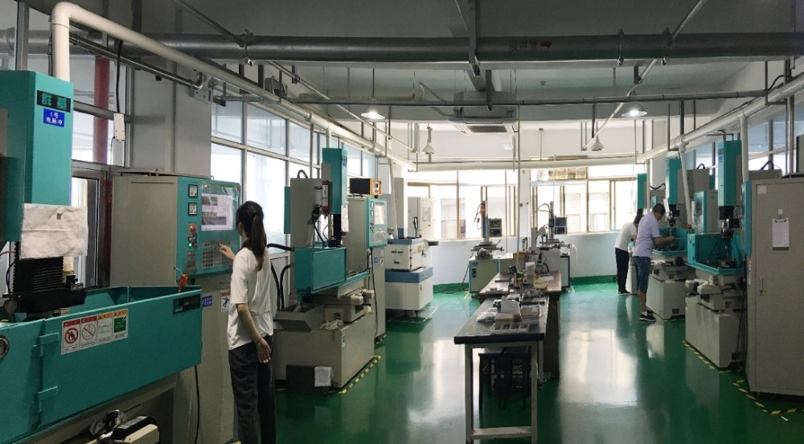
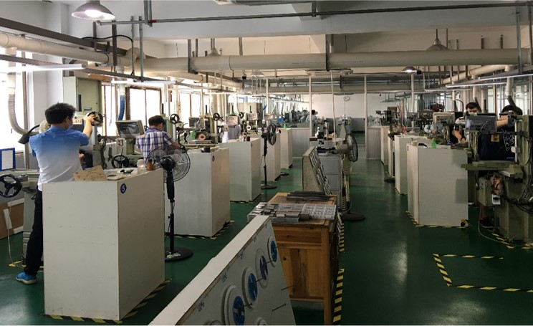
模具研发 Mold Development
三菱慢走丝
Mitsubishi WEDM
阿奇夏米尔GF电加工和工艺磨床
AgieCharmilles GF Electrical Machining &Process Grinding Machines

Slide 28
研发设备 R & D Equipment
设备 Equipment | 数量 Quantity | 产地 | 厂家
电加工+GF+(Electromachining +GF+) | 10 | 瑞士(Switzerland) | 阿奇夏米尔(Archie Charmilles)
慢走丝切割机(Slow wire cutting machine) （精度可达2μ，Accuracy up to 2 μ） | 5 | 日本(Japan) | 三菱(Mitsubishi)
电火花机(Electric discharge machine) | 9 | 瑞士 | 阿奇夏米尔(Archie Charmilles)
精密成型磨床(Precision Form Grinder) | 40 | 中国台湾(CN TW) | 宇青(Yuqing)
精密成型磨床(Precision Form Grinder) | 20 | 中国台湾(CN TW) | 準力(JOEN LIH)
放电加工机(Discharge processing machine) | 5 | 中国台湾(CN TW) | 群基(Creator)

Slide 29
技术研发和人才储备R&D Team
150人
20位
32人
20项
研发团队
150 people R & D team
工程师
20 engineers
10年从业经验者
10 years working experience
20余项国家产品专利
Over 20 patents
人类创造技术，技术成就人类
Man creates technology, technology makes man
  在快速发展的21世纪，企业核心竞争力越来越表现为对作为第一资本的人才的培育、拥有和运用潜力。人才是推动企业健康发展的力量源泉，无论从宏观角度，还是从微观角度来看人才是企业发展的决定性因素。因此，我们注重开发团队的建设，在公司内部进行人才选拔和培训。人员精进，才能开展技术工作的改革和创新，公司现有能力可加工100副模具/年，持续优化，预计2025年加工模具能力可以到达200副/年。
  Talent is the source of power to promote the healthy development of the enterprise. Therefore, we pay attention to the construction of the development team and carry out talent selection and training within the company. Only with improved personnel can we carry out the reform and innovation of technical work. The existing capacity of the company can process 100 pairs of molds/year, and it is expected that the processing capacity of molds can reach 200 pairs/year in 2025。

Slide 30
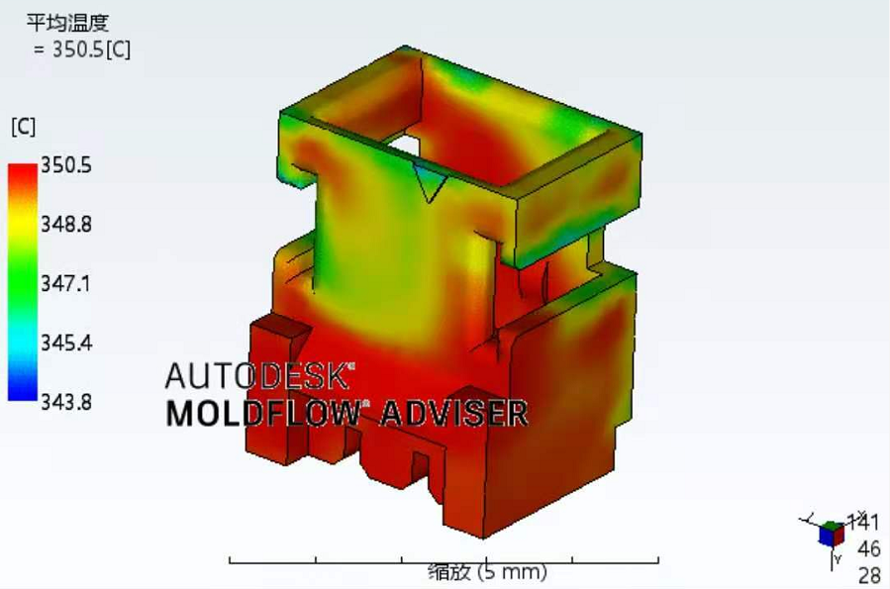
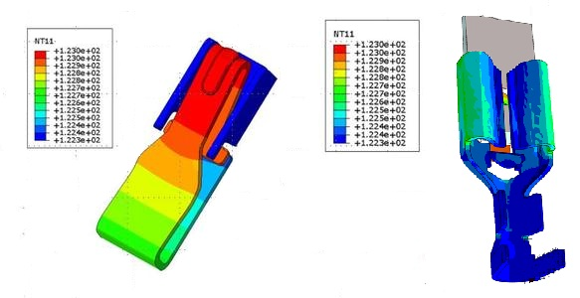
产品性能应用研究Performance Application Research
Moldflow 模流分析
MSC 有限元分析
通过模流分析，可以优化模具设计，提高塑料制品的成型质量及效率，降低制造成本。
Function of mold flow analysis：1.Mold design can be optimized
2.Improve molding quality and efficiency of plastic products 3. Cost reduced.

Slide 31
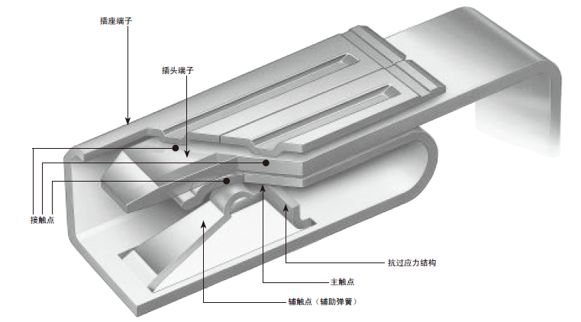
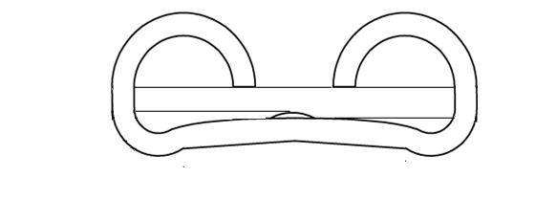
产品性能应用研究Performance Application Research
接点压力调节型端子
Contact pressure adjustable terminal
应力松弛产生原因
The cause of stress relaxation
有应力残余，配合时形成张力，不能回弹，导致开口变大
There is residual stress, which forms tension when mating and cannot rebound, resulting in a larger opening
通过应力分析，可以确保端子的设计和使用符合安全标准，避免因应力过大而导致的故障和事故。
Through stress analysis, to ensure that the design and use of terminals comply with safety standards and avoid failures and accidents caused by excessive stress.

Slide 32
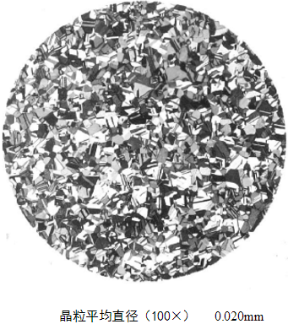
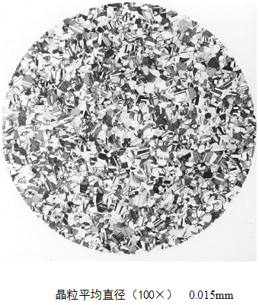
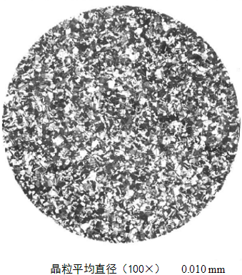
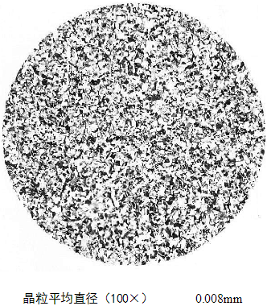
铜材研究与选择Copper Research And Selection
金属的晶粒大小对金属的许多性能有很大影响。晶粒度的影响，实质是晶界面积大小的影响。晶粒越细小则晶界面积越大，对性能的影响也越大。
对于的常温力学性能来说，一般是晶粒越细小，则强度和硬度越高，同时塑性和韧性也越好。影响产品耐疲劳性、弹性、强度和成型折弯性能。
The grain size of a metal has a great influence on many properties of the metal. The effect of grain size is essentially the effect of the size of the grain boundary area. The finer the crystal grains, the larger the grain boundary area and the greater the impact on performance. For the mechanical properties of metals at room temperature, generally the finer the crystal grains, the higher the strength and hardness, and the better the plasticity and toughness. Affect product fatigue resistance, elasticity, strength and forming bending performance.

Slide 33
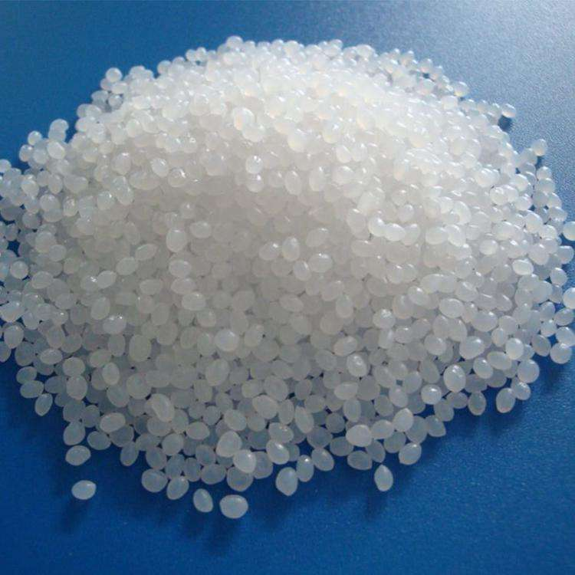





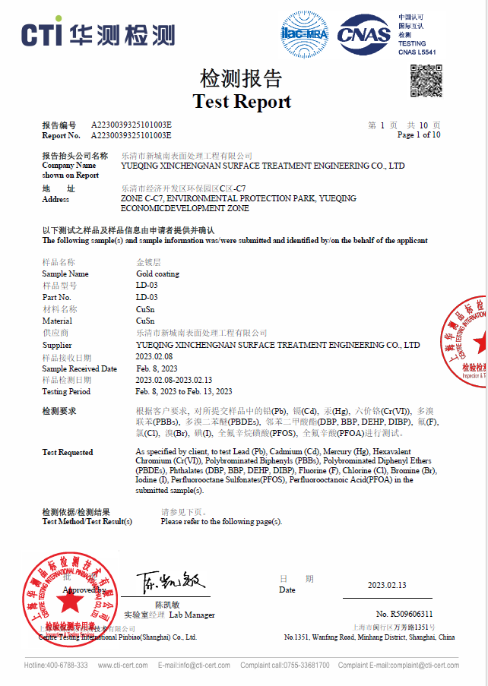
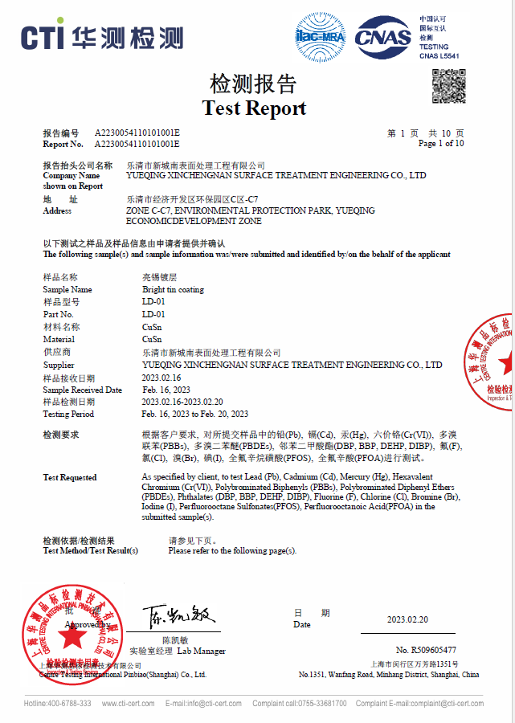
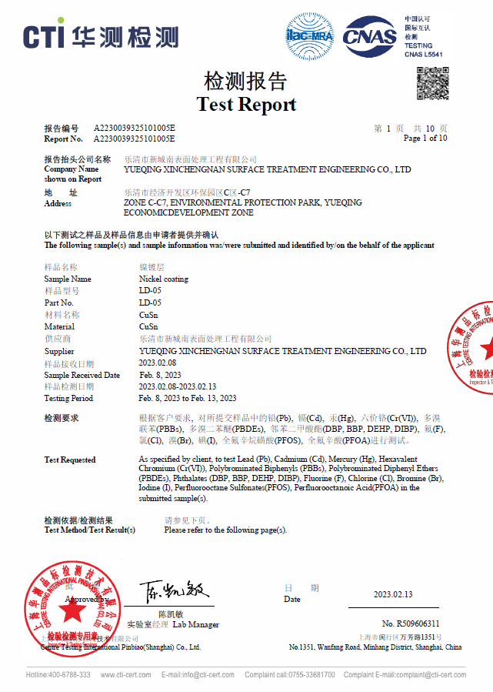
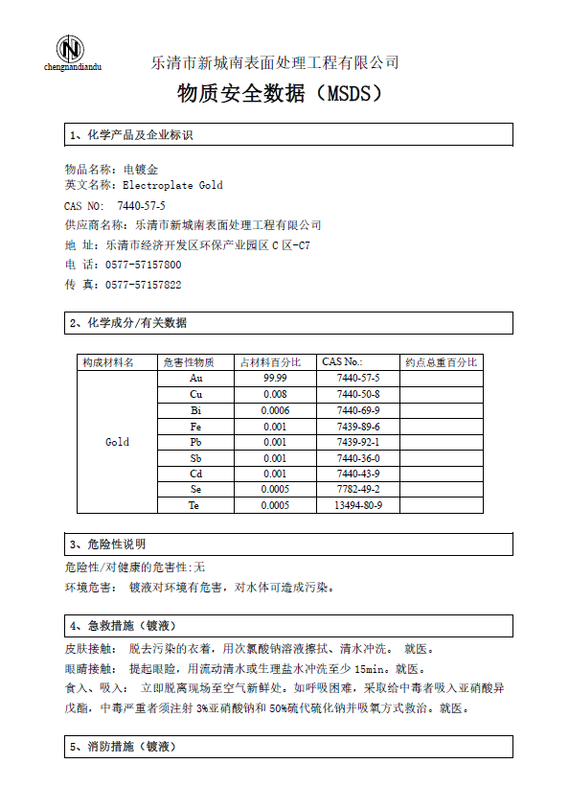
原材料供应商及品质保障Raw material Quality Assurance
进口原材料：塞拉尼斯、宝理、英威达、奥升德、可乐丽等
Celanese, Polyplastics, INVISTA, Ascend, Kuraray, etc.
端子电镀层符合ROHS,REACH，且供应商每批次交货提供测试报告，以保证每批次的质量
plating layer complies with ROHS, REACH

Slide 34
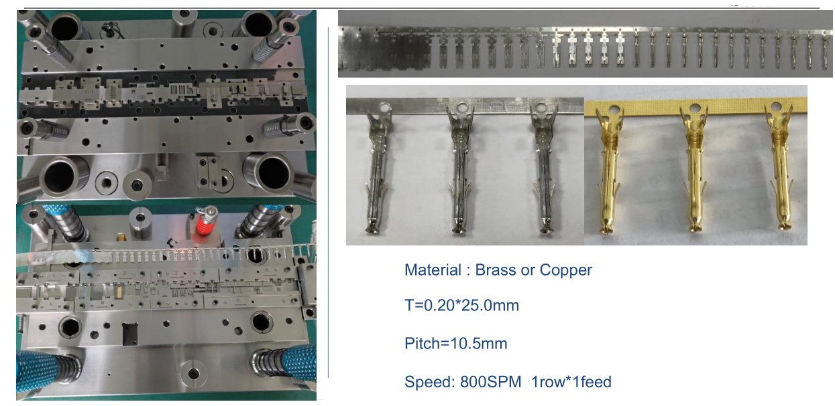
冲压模具Stamping Mould

Slide 35
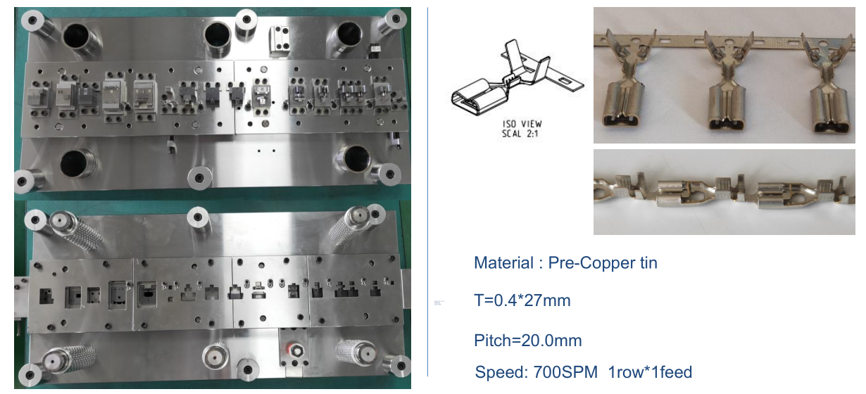
冲压模具Stamping Mould

Slide 36

研发能力 R & D Capabilities
协助客户完成连接器标准化需求。
Assist customers in meeting connector standardization requirements.
标准化的制定能力
Ability to develop standardization
协助客户完成连接器个性化需求。
Assist customers to complete the personalized requirements of connectors.
卓越的制定能力
Excellent formulation ability
协助客户完成连接器个性化需求。同时灼热丝，原料注塑产品型号齐全，交期迅速
Assist customers to complete the personalized requirements of connectors.
Meantime glow wire, raw material injection molding product type complete, fast delivery!
卓越的定制能力
Excellent formulation ability
针对客户的问题痛点，持续工艺改进，如挂钩断裂、应力不足、缺针、焊后高低针等。
Aiming at the pain points of customers' problems, continuous process improvement, such as broken hooks, insufficient stress, missing pins, high and low pins after welding, etc.
工艺改进能力
Process improvement capability
针对客户的问题痛点，持续工艺改进，如挂钩断裂、应力不足、缺针、焊后高低针等。
Aiming at the pain points of customers' problems, continuous process improvement, such as broken hooks, insufficient stress, missing pins, high and low pins after welding, etc.
工艺改进能力
Process improvement capability
互配验证能力
Interworking Verification
Capability
完全替代性验证，包括材料镀层分析，产品耐氨腐蚀性和冷热冲击后的高频振动等可靠性的对比测试。
Complete substitution verification, including material coating analysis, product ammonia corrosion resistance and high-frequency vibration after thermal shock and other reliability comparison tests.
互配验证能力
Interworking Verification
Capability
完全替代性验证，包括材料镀层分析，产品耐氨腐蚀性和冷热冲击后的高频振动等可靠性的对比测试。
Complete substitution verification, including material coating analysis, product ammonia corrosion resistance and high-frequency vibration after thermal shock and other reliability comparison tests.

Slide 37
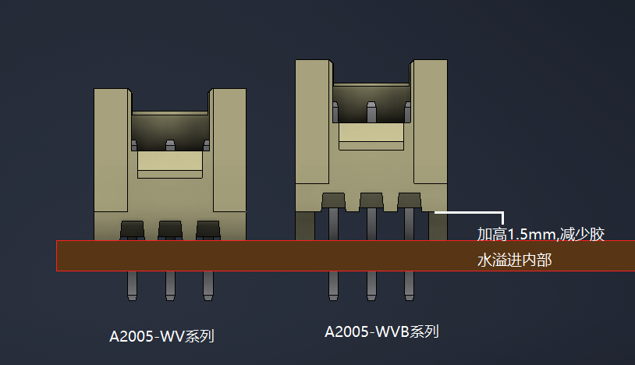
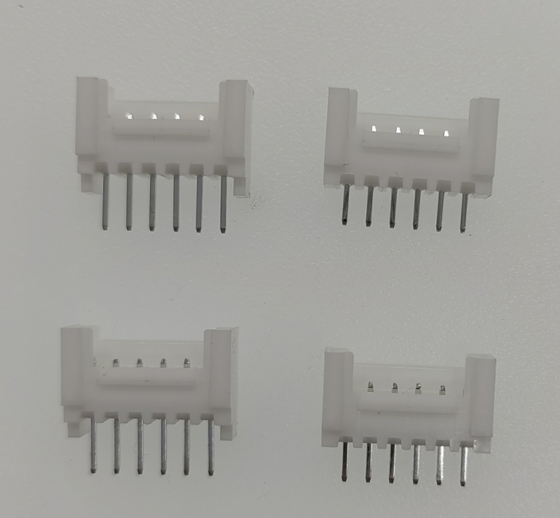
定制案例分享Customized Case
客户:九号
Client: NINE
产品：A2005-WV系列
Item: A2005-WV
客户要求: PCB板焊后灌胶防水
Request: glue filling and waterproofing of PCB boards after welding
现有产品:只能满足常规贴片使用，容胶量少且有溢胶
Current item: only meet the use of conventional patches, with less glue capacity and overflowing glue
定制改善 : 模具调整塑件加高，增大容胶量，同步加长铜针，保证外露针长不变
Customized improvement :Adjust the height of the plastic part by mold adjustment, increase the plastic capacity, and lengthen the copper needle simultaneously to ensure that the length of the exposed needle remains unchanged
最终产品:A2005-WVB系列
Final item: A2005-WVB

Slide 38
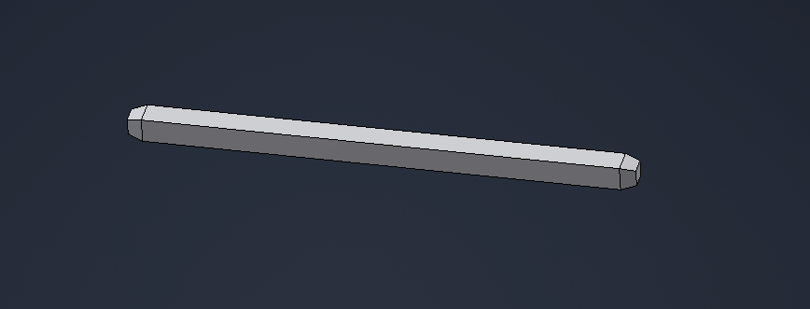
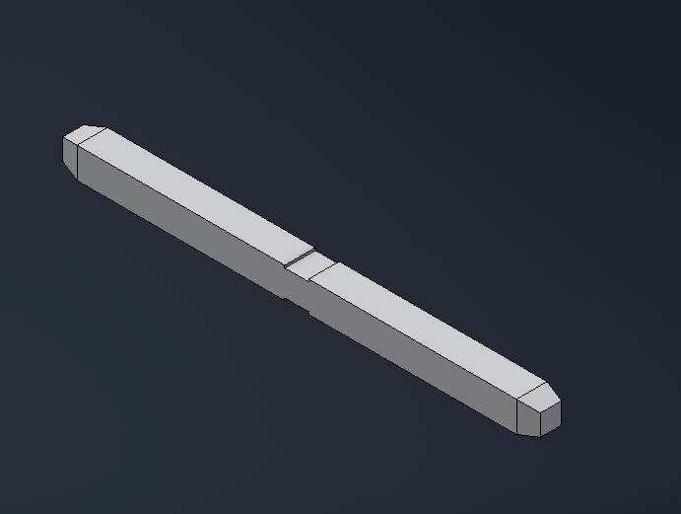
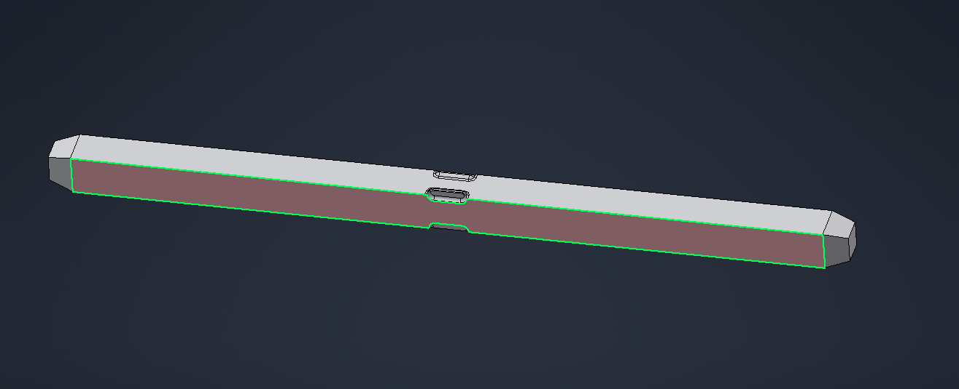
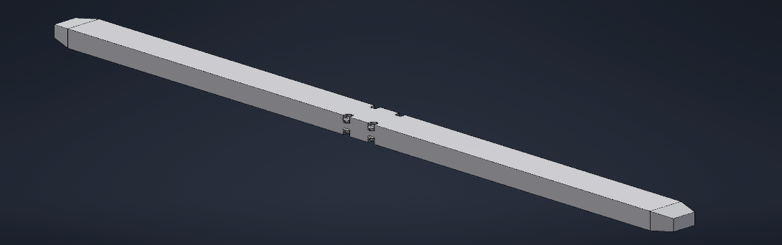
工艺改进分享Process Improvement
最先使用的是无咬花工艺的铜针，会受材质与使用环境的影响，出现焊后高低的风险
The first copper needles with no chipping process are used, there will be a risk of high or low after welding.
工艺改善，采购上下咬花工艺的铜针，明显增加的产品的固定力；但受限于铜针加工商的影响，深度波动大，尺寸不稳定
Improve the needle with an up and down bite mode, which increases the fixation force, but the bite depth is unstable
工艺改善，采购左右咬花工艺的铜针，明显增加的产品的固定力；但受限于铜针加工商的影响，咬花波动大，尺寸不稳定
Improve the needle with a left and right bite pattern, which increases the fixation force, but the bite size is unstable.
最终改良，采用机台设备四面咬花工艺，增大接触面，增强焊后固定力，且内部梳理管控，彻底解决固定力及咬花不稳定的问题
The final improvement, adopting the four-sided scratching process of the machine equipment, increasing the contact surface, enhancing the fixing force after welding.

Slide 39
Part 03
制造能力
Manufacturing capacity

Slide 40
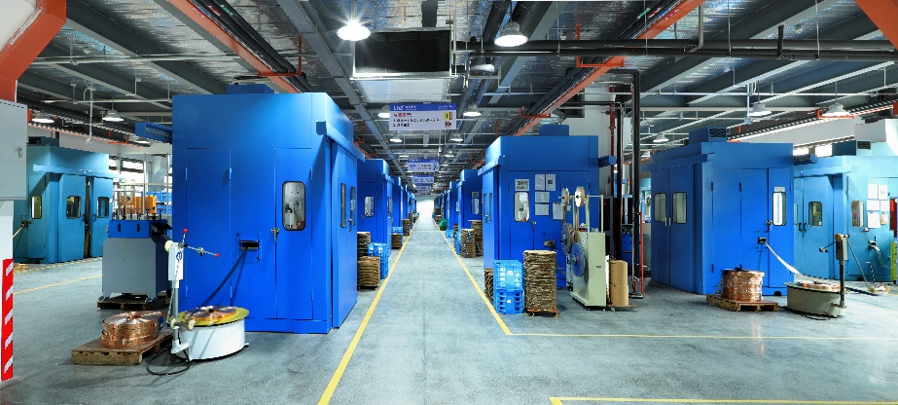


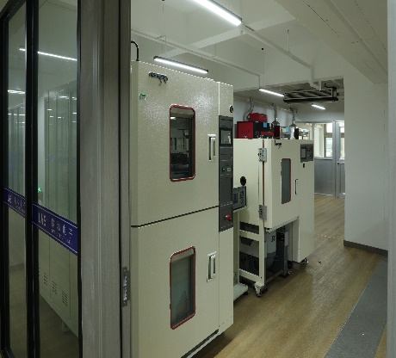
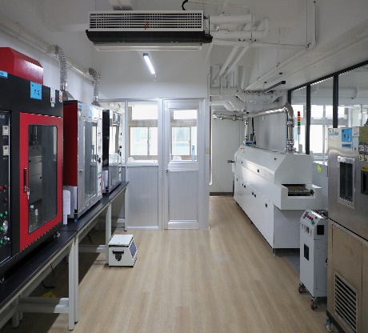

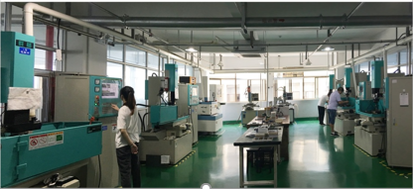
厂房设备Equipment
精良设备
Advanced Equipment
公司拥有配置完善的全自动化生产线车间，保障高产能、高效率。冲压车间拥有台湾明勖高速冲床80余台，配备了完善的在线监测设备，隔音设施，可年产精密端子100亿只以上；注塑车间现有90余台注塑机，全部采用中央供料系统并配备了全自动机械手，年产塑壳50亿只以上；插针车间拥有全自动插针机及端子焊着装配机共计200余台，可年产针座30亿只以上
检测设备
Test Equipment
公司以科技为先导，大力进行技术改造、设备革新；引进了一批德国、日本高精密电加工设备和检测设备，建立了ISO9001，IATF16949质量管理体系,努力增强公司的产品设计、模具开发和制造实力
The company has a well-equipped fully automated production line workshop to ensure high productivity and high efficiency. There are more than 80 Taiwan Mingxu high-speed presses in workshop, equipped with CCD online test and sound insulation facilities. The annual output is more than 10 billion. Injection molding workshop has more than 90 injection molding machines, all using the central feeding system and equipped with automatic manipulator, annual output more than 5 billion; The pin insert workshop has more than 300 sets of automatic pin insert machines and terminal welding assembly machines, with an annual output of more than 3 billion pins.
Lianhe takes science and technology as the forerunner, vigorously carries out technical transformation, equipment innovation; Introduced a number of German, Japanese high precision electric processing equipment and testing equipment, established ISO9001, IATF16949 quality management system, and strive to enhance the company's product design, mold development and manufacturing strength.

Slide 41
生产设备Production Equipment
设备 | 数量 | 产地 | 厂家
注塑机(injection molding machine )MA1600/540 | 90 | 中国(China) | 海天(Haitian)
高速冲床(High speed punch)M40T-35 | 80 | 中国台湾(Taiwan, China) | 明勋(MINGXU)
全自动压针产线(Fully automatic crimping production line) | 200 | 中国(China) | LHE自主研发设计(LEH Design)
SMT贴片包装检测机(SMT patch packaging inspection machine) | 22 | 中国(China) | LHE自主研发设计(LEH Design)
AI纸编带机(AI paper tape machine) | 20 | 中国(China) | 一川(Issen)
全自动光学计数包装机(Fully automatic optical counting packaging machine） | 5 | 中国(China) | 智皖(Zhiwan)
CCD 在线监测(CCD online monitoring) | 280 | 德国Germany | 巴斯勒(Basler)

Slide 42
生产能力Production Capacity
海天注塑机90台年平均制造50亿PCS连接器及前车组合开关
Haitian injection molding machine 90 sets annual average production of 5 billion PCS connectors and front vehicle combination switch
5,000,000,000
明勋高速冲床80台年平均生产100亿PCS连接器端子
80 units Mingxun high-speed presses produce an average of 10 billion connector terminals per year
10,000,000,000
全自动压针产线200台年平均产30亿PCS连接器针座
200 sets of fully automatic crimping production lines with an average annual output of 3 billion pcs connector wafer holders
3,000,000,000

Slide 43
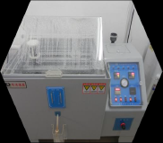
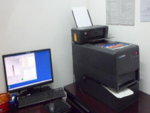
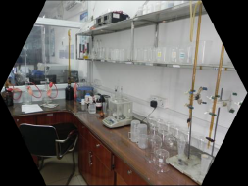
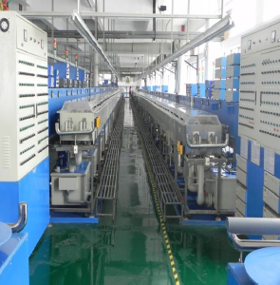
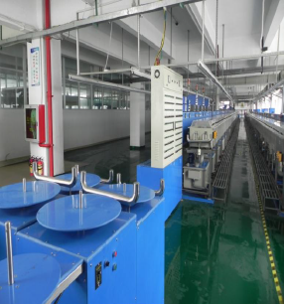
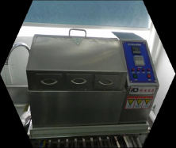

电镀供应商的产能及设备Capacity And Equipment of Electroplating Suppliers
我司有浙江深圳两大家供应商，以保证电镀质量和产能充足
Two suppliers in Zhejiang and Shenzhen to ensure the quality of electroplating and sufficient production capacity
供应商目前设备（1机2线与1机4线）产能：320万KPCS/月（后续根据市场及客户需求加线，最终可达800-1000万KPCS/月）
The supplier's current production capacity of equipment (1 machine, 2 lines and 1 machine, 4 lines) : 3.2 million KPCS/ month (additional lines will be added according to market and customer demand, and the final capacity can reach 8-10 million KPCS/ month)
正常加工交货期(normal lead time)：2-3天/days
急件加工交货期(urgent order lead time)：1-2天/days
检测设备
生产车间一角
膜厚测试仪
Film thickness tester
盐雾试验箱
Salt spray test chamber
药水化验仪器
Potion testing equipment
蒸汽老化试验箱
Steam aging test chamber
高温老化试验箱
High temperature aging test chamber

Slide 44
Part 04
质量保障能力
Quality Assurance Capability

Slide 45




实验室验证能力Laboratory Verification Capabilities
Dimension
全尺寸
Mechanical
机械
带表卡尺
外径千分尺
数显卡尺
影像测量仪
全自动插拔力试验机
电动振动试验系统
瞬断测试仪
智能扭力测试仪
数显扭矩起子
指针式推拉力计
电子万能试验机
维氏硬度计
端子截面分析仪
D E E M
产品规格
除了IATF 16949 ，ISO9001，ISO14001，ISO45001，UL，CUL，CE，CQC，ROHS，REACH等十余项认证，LHE内部实验室作为保护伞，保护所有产品， 以配合客户和设计工程要求
Environmental
Electrical
电性能
毫欧姆电阻分选仪
绝缘电阻测试仪
直流稳定电源
多路温度记录仪
抗电强度实验装置
耐压测试仪
环境
可程式高低温交变湿热试验箱
盐雾腐蚀试验箱
无铅钵锡炉
二氧化硫试验机
氨气真空实验箱
两箱冲击试验箱
回流焊
能量色散型X射线荧光光谱仪
X射线镀层测厚仪
漏电起痕试验仪
灼热丝试验仪
针焰试验仪
球压试验装置
数字温湿度计
机械温湿度计

Slide 46
Laboratory Verification Capabilities
Dimension
Mechanical
Calipers with watch
Outside micrometer
digital caliper
Image Measuring Instrument
Fully automatic insertion force testing machine
Electrodynamic Vibration Test System
Transient tester
Smart Torque Tester
Digital torque driver
Pointer Push Pull Gauge
Electronic universal testing machine
Vickers Hardness Tester
Terminal Section Analyzer
D E E M
Product specification
In addition to more than ten certifications such as IATF 16949, ISO9001, ISO14001，ISO45001, UL, CUL, CE, CQC, ROHS, REACH, etc., LHE's internal laboratory acts as a protective umbrella to protect all products to meet customer and design engineering requirements
Environmental
Electrical
Milliohm Resistance Sorter
Insulation Resistance Tester
DC stabilized power supply
Multiplex temperature recorder
Dielectric strength test device
Pressure tester
Programmable high and low temperature alternating damp heat test chamber
Salt spray corrosion test chamber
Lead-free tin pot
Sulfur dioxide testing machine
Ammonia vacuum test box
Two box impact test box
reflow soldering
Energy Dispersive X-ray Fluorescence Spectrometer
X-ray coating thickness-
-gauge
Tracking Tester
Glow Wire Tester
Needle Flame Tester
Ball pressure test device
Digital Thermo-Hygrometer
Mechanical Thermo-Hygrometer

Slide 47




内部实验室Internal Laboratory

Slide 48
品质管理Quality Management
生产调试
Production commissioning
来料通知
Incoming notification
合格入库
Qualified storage
小规模生产
small scale production
重新检验
retest
置报废区
waste area
OK
NG
进货检验incoming inspection
批量生产
mass production
OK
首模检验
First mold inspection
特采返工Special rework
报废标识
Scrap mark
NG
不合格评审unqualified review
包装入库Packaging and storage
OK
过程检验
Process inspection
NG
不良分析
Failure analysis
责任单位判定 Responsible Unit Judgment
OK
退货区
Return area
特采使用区
special use area
包装出库
Packaging out of the warehouse
出货检验
Shipping inspection
NG
纠正预防措施Corrective and preventive measures
品管部Quality Control Department
退给供应商
return to supplier
修正使用correct use
选择使用choose to use
发货出库
Ship out
效果确认Effect confirmed
工程部engineering department
客户反馈
client feedback
8D报告
NG
效果标准化normalization

Slide 49


品质管控-冲压Quality Control - Stamping
合格率99.7%以上
良品误报不良品排废0.05-0.15%
不良品报良品0%
Pass rate over 99.7%
0.05-0.15% of good products are falsely reported and defective products are discharged
Defective products report good products 0%

Slide 50


品质管控-注塑
模内监控系列
In-mold monitoring series
模温控制系统Mold temperature control system

Slide 51


品质管控-针座组装Quality Control - Seat Assembly
全自动插针检测装管机
合格率99.7%以上
良品误报不良品排废0.05-0.15%
不良品报良品0%
Automatic pin detection tube loading machine
Pass rate over 99.7%
0.05-0.15% of good products are falsely reported and defective products are discharged
Defective products report good products 0%

Slide 52



品质管控-包装Quality Control - Packaging
端子自动包装机
Terminal Automatic Packaging Machine
塑件自动包装机
Plastic parts automatic packaging machine

Slide 53
品质保证对比Quality Assurance Comparison
项目Project | 以往Before | 现在Now
人才团队talent team | 模具设计师为主导Leading by mold designer | 多学科交叉人才团队，包括产品设计师、模具结构工程师、材料应用工程师、工艺分析师等Multidisciplinary talent team, including product designers, mold structure engineers, material application engineers, process analysts, etc.
材料Material | 管控牌号、硬度Control grade, hardness | 晶粒度、抗拉、弹性模量、成分分析 Grain size, tensile, elastic modulus, composition analysis
产品设计 Product design | 模仿进口尺寸copy original brand dimension | 有限元分析、结构分析、三维仿真 Finite element analysis, structural analysis, 3D simulation
模具设计 mold design | 纸面理论核算 Theoretical calculation on paper | 模流分析，全3D分模技术 Mold flow analysis, full 3D parting technology
模具加工 Mold processing | 基础加工设备 Basic processing equipment | 三维精雕、工显检测 3D fine carving, industrial display inspection
产品验证 Product verification | 常规实验机械测试Routine Experimental Mechanical Testing | 温升过载、冲击振动、盐雾测试，温度循环，机械寿命，机械振动等 Temperature rise overload, shock vibration, salt spray test, temperature cycle, mechanical life, mechanical vibration, etc.
生产过程 Production process | 生产设备无辅助自动化Production equipment without auxiliary automation | 自动包装、自动防呆、MES系统、工艺参数保障Automatic packaging, automatic fool-proof, MES system, process parameter guarantee
过程检验 Process inspection | 人为抽检 Artificial sampling | CCD模保，在线CCD全检 CCD mold protection, online CCD full inspection

Slide 54




互配测试验证Interworking Test Verification

Slide 55
Part 05
认证和荣誉
Certification and Honor

Slide 56



















认证荣誉Certification Honor
PFAS

Slide 57















认证荣誉Certification Honor

Slide 58












专利证书Patent Certificate
ZL201820871246.X
ZL201820871392.2
ZL201820871430.4
ZL201820871552.3
ZL201820872030.5
ZL201820874262.4
ZL201820874273.2
ZL201920299528.1
ZL202021745838.0
ZL202021747698.0
ZL202021756511.3
ZL202021757286.5

Slide 59


联系我们Contact us
总部：浙江联和电子有限公司
浙江省乐清市乐清湾港区红旗路8号
T: (86) -577-62383212
F: (86) -577-62382566
E: lhecn01@lhecn.net lhecn03@lhecn.net
中文站 www.lhecn.com.cn
英文站 www.lhecn.com
附属公司
浙江联和进出口有限公司
温州联和汽车零部件有限公司
Spanish Office
Setting Cost S.L.
Mariano Pinel
General Manager
Email:mpinel@settingcost.es
ADD:Pol.Valdeconsejo, C/Pena Orel parcela 5D, nave 2
50410-Cuarte de Huerva-Zaragoza-Spain
Tel:+34 638581929
Italy office
Eldeco Elettronica Srl
Attn:Elena Cellerai(Supplier Relationship Manager ),
Email:elena.cellerai@cbcelettronica.it,
ADD: VIA GIORDANO BRUNO N. 83, 10134 TORINO-ITALY)
Attn： Ramona
Tel:011/3804068 ,Tel .011/3804068 Fax.011/3806084
South Korea Office
JL TECH CO.,LTD (주식회사 제이엘텍코퍼레이션)
Alice Zhang
General Manager
Email: zhanghaiqin@jltech.co.kr
ADD: 32-16, Techno 7-ro, Yuseong-gu, Daejeon, ZIP 34029, South Korea (대전광역시 유성구 테크노7로 32-16 4층)
Tel: 82+704162-4428, +82-42936 4988

Slide 60

联万物
以和
Zhejiang Lianhe Electronics Co., Ltd.
Simple connecting
PPT模板下载：www.1ppt.com/moban/ 行业PPT模板：www.1ppt.com/hangye/
节日PPT模板：www.1ppt.com/jieri/ PPT素材下载：www.1ppt.com/sucai/
PPT背景图片：www.1ppt.com/beijing/ PPT图表下载：www.1ppt.com/tubiao/
优秀PPT下载：www.1ppt.com/xiazai/ PPT教程： www.1ppt.com/powerpoint/
Word教程： www.1ppt.com/word/ Excel教程：www.1ppt.com/excel/
资料下载：www.1ppt.com/ziliao/ PPT课件下载：www.1ppt.com/kejian/
范文下载：www.1ppt.com/fanwen/ 试卷下载：www.1ppt.com/shiti/
教案下载：www.1ppt.com/jiaoan/
字体下载：www.1ppt.com/ziti/

